Slide 1
Data Structures and Algorithm Chapter 07

Slide 2
Trees – Binary Tree
Data Structures and Algorithm

Slide 3

Trees
Siblings
Depth
Degree of node
Internal node
Leaf node
Successor node
Height
Children
Path
Parent node
Ancestor
Descendant
Root

Slide 4
Binary Tree
A binary tree is a tree data structure in which each node has at most two children.
The arbitrary number of children in general trees is often unnecessary—many real-life trees are restricted to two branches
Expression trees using binary operators
An ancestral tree of an individual, parents, grandparents, etc.
Phylogenetic trees
Lossless encoding algorithms
A binary tree is a tree data structure in which each parent node can have at most two children. Each node of a binary tree consists of three items:
data item
address of left child
address of right child
A binary tree is a hierarchical data structure in which each node has at most two children generally referred as left child and right child.
Pointer to left subtree
Pointer to right subtree
Data element

Slide 5
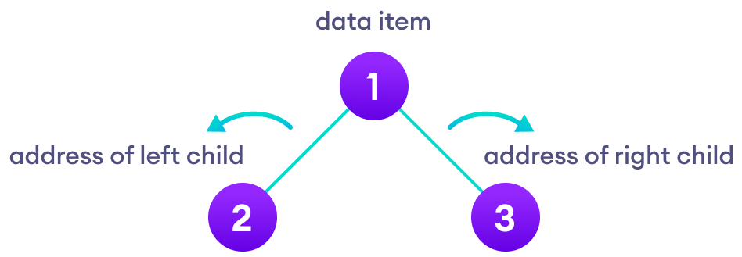
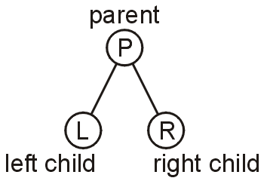
Binary Tree
A binary tree is a restriction where each node has exactly two children:
Each child is either empty or another binary tree
This restriction allows us to label the children as left and right subtrees

Slide 6
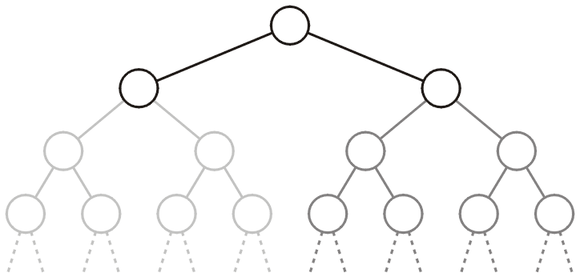
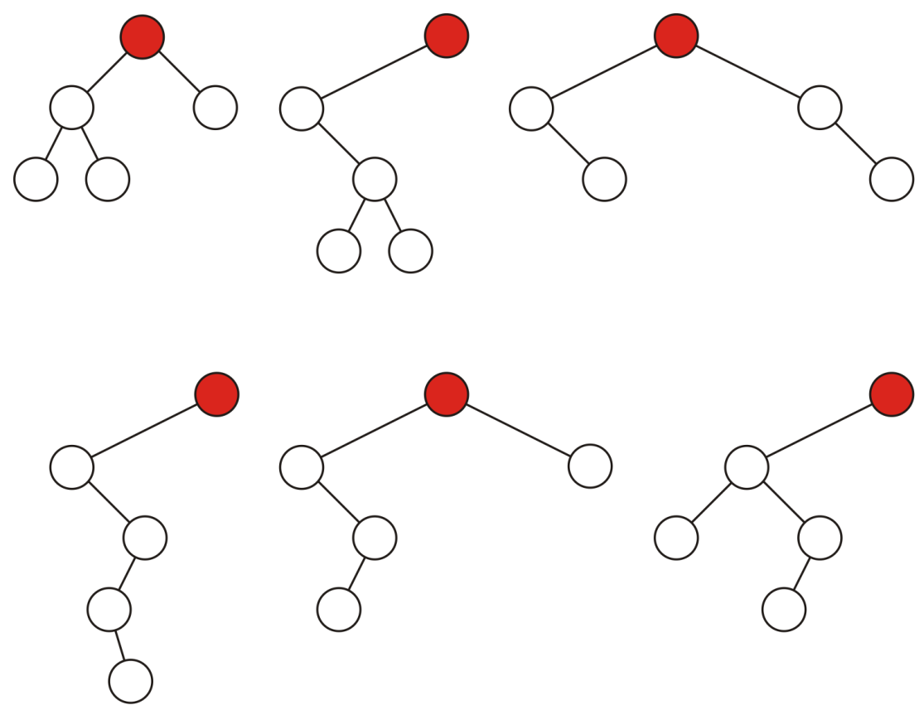
Binary Tree
We will also refer to the two sub-trees as
The left-hand sub-tree,
The right-hand sub-tree
Sample variations on binary trees with five nodes:

Slide 7
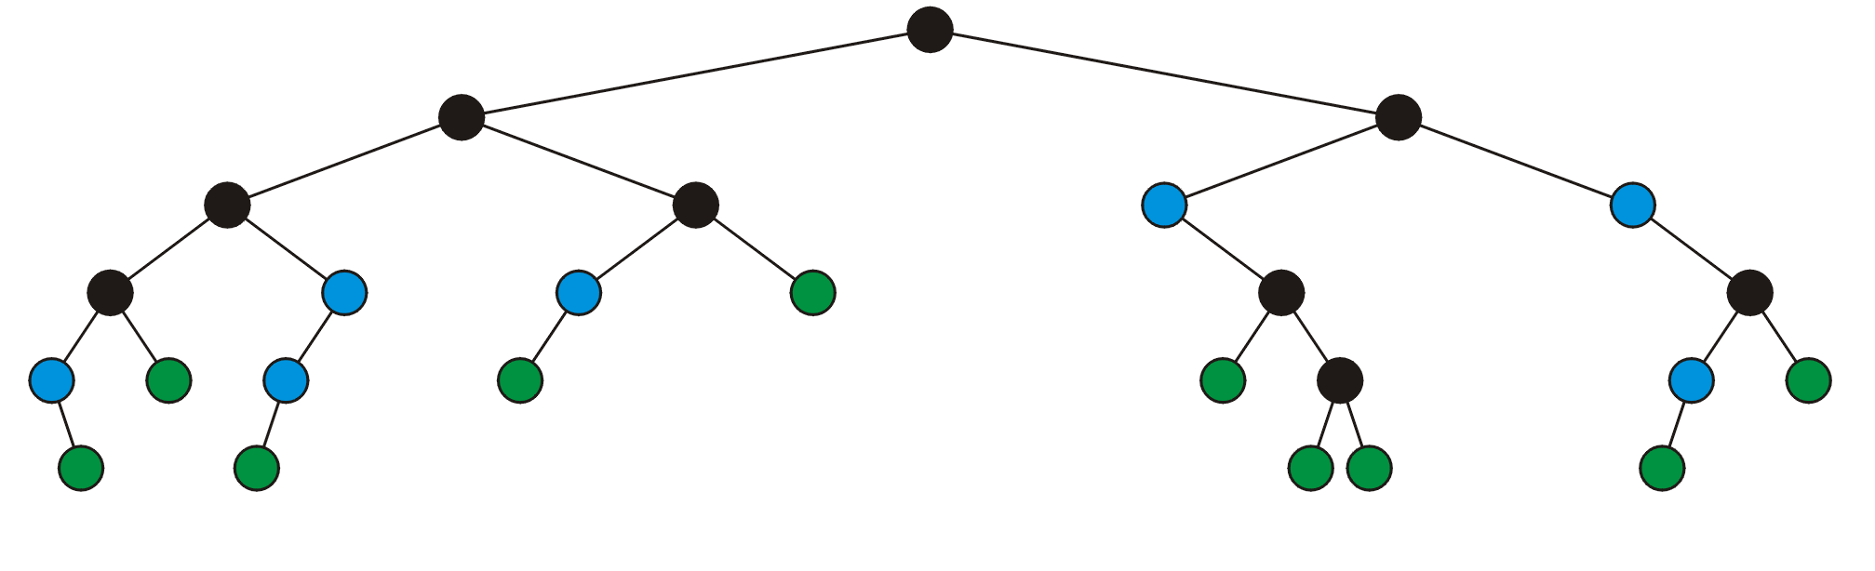
Full node
A full node is a node where both the left and right sub-trees are non-empty trees
Legend:
Full nodes
Neither
Leaf nodes

Slide 8
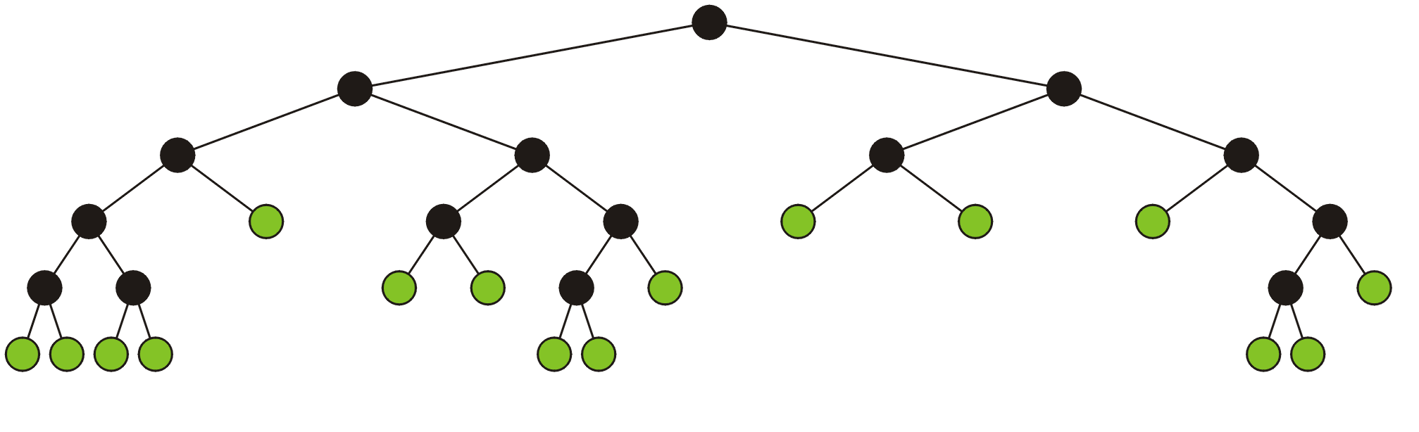
Full node
A full binary tree is where each node is:
A full node, or
A leaf node
These have applications in
Expression trees
Huffman encoding

Slide 9
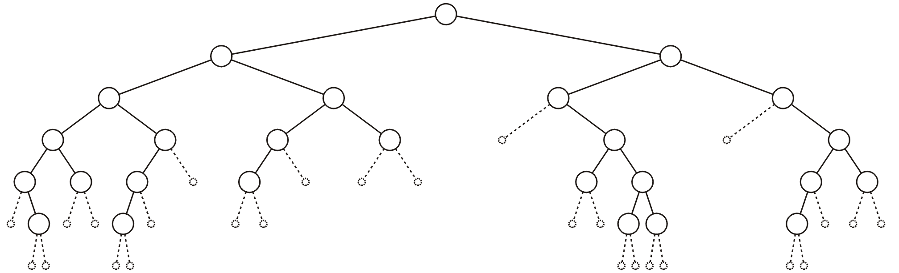
Empty node
An empty node or a null sub-tree is any location where a new leaf node could be appended

Slide 10
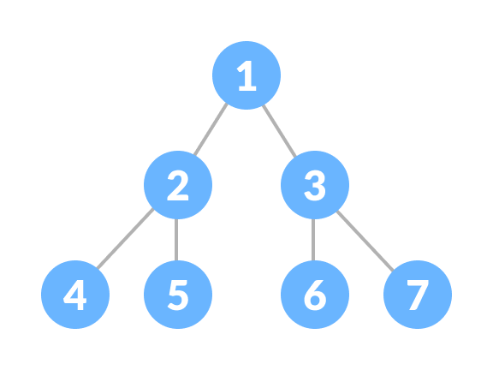
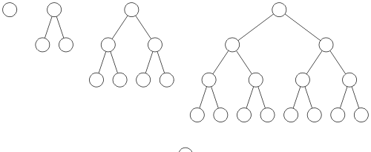
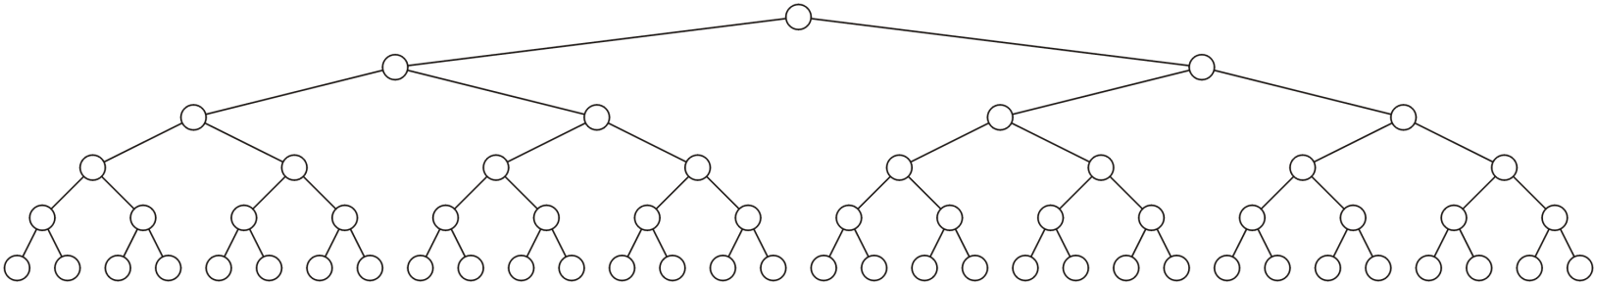
Perfect Binary Tree
A perfect binary tree is a type of binary tree in which every internal node has exactly two child nodes and all the leaf nodes are at the same level.
A perfect binary tree of height h is a binary tree where
All leaf nodes have the same depth h
All other nodes are full

Slide 11
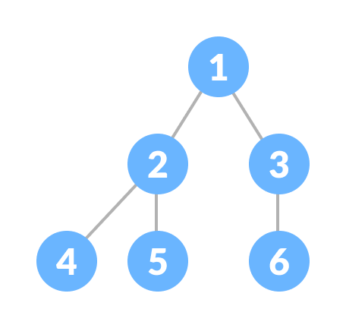
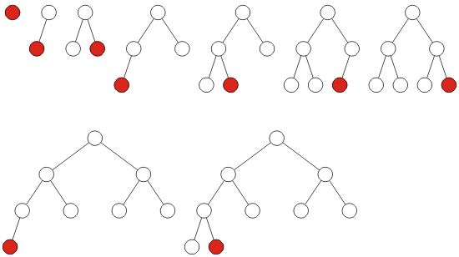
Complete Binary Tree
A complete binary tree is just like a full binary tree, but with two major differences
Every level must be completely filled
All the leaf elements must lean towards the left.
The last leaf element might not have a right sibling i.e.
a complete binary tree doesn't have to be a full binary tree.
A complete binary tree filled at each depth from left to right:

Slide 12
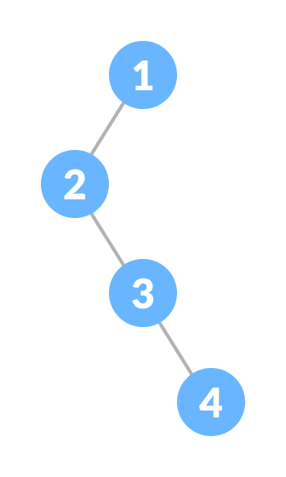
Degenerate or Pathological Tree
A degenerate or pathological tree is the tree having a single child either left or right.

Slide 13
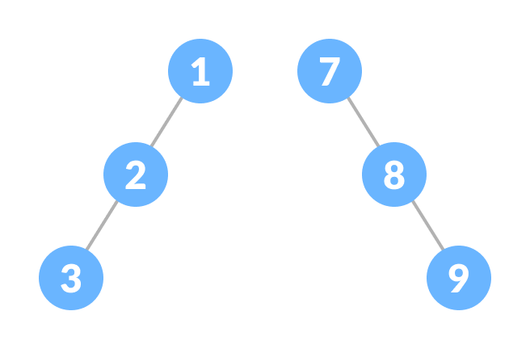
Skewed Binary Tree
A skewed binary tree is a pathological/degenerate tree in which the tree is either dominated by the left nodes or the right nodes. Thus, there are two types of skewed binary tree: left-skewed binary tree and right-skewed binary tree.

Slide 14
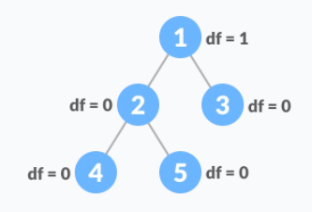
Balanced Binary Tree
It is a type of binary tree in which the difference between the height of the left and the right subtree for each node is either 0 or 1.

Slide 15
Run Times
Recall that with linked lists and arrays, some operations would run in O(n) time
The run times of operations on binary trees, we will see, depends on the height of the tree
We will see that:
The worst is clearly O(n)
Under average conditions, the height is
The best case is O(ln(n))

Slide 16
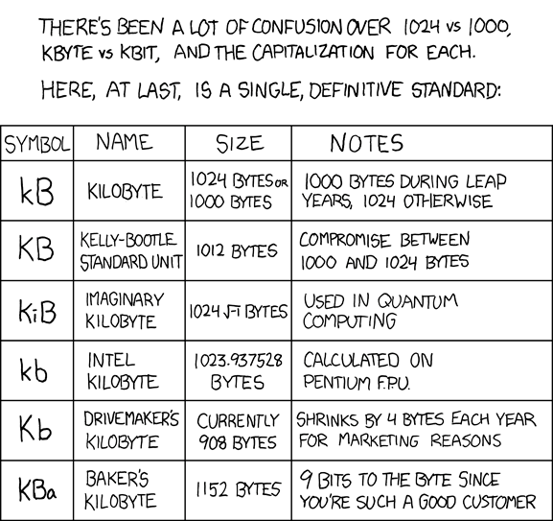
Run Time
If we can achieve and maintain a height O(lg(n)), we will see that many operations can run in Q(lg(n)) we
Logarithmic time is not significantly worse than constant time:
lg( 1000 ) ≈ 10 kB
lg( 1 000 000 ) ≈ 20 MB
lg( 1 000 000 000 ) ≈ 30 GB
lg( 1 000 000 000 000 ) ≈ 40 TB
lg( 1000n ) ≈ 10 n

